Slide 1
Library Management System
Project for MPP course
September 2024
Group No. 2
Marwane Bidamou
Temuulen Khuchit
Maria Luisa Lamprea

Slide 2
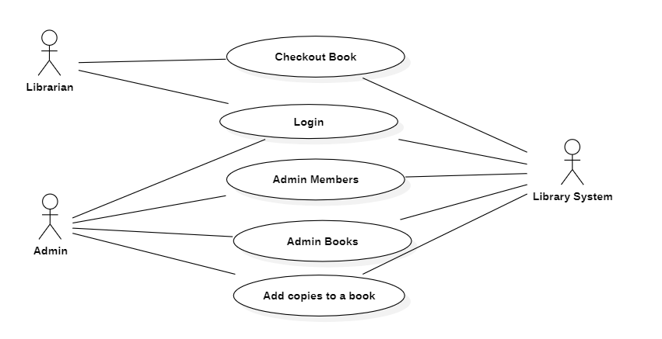
Use Case Diagram

Slide 3
Class Model for add new Library Member use case

Slide 4
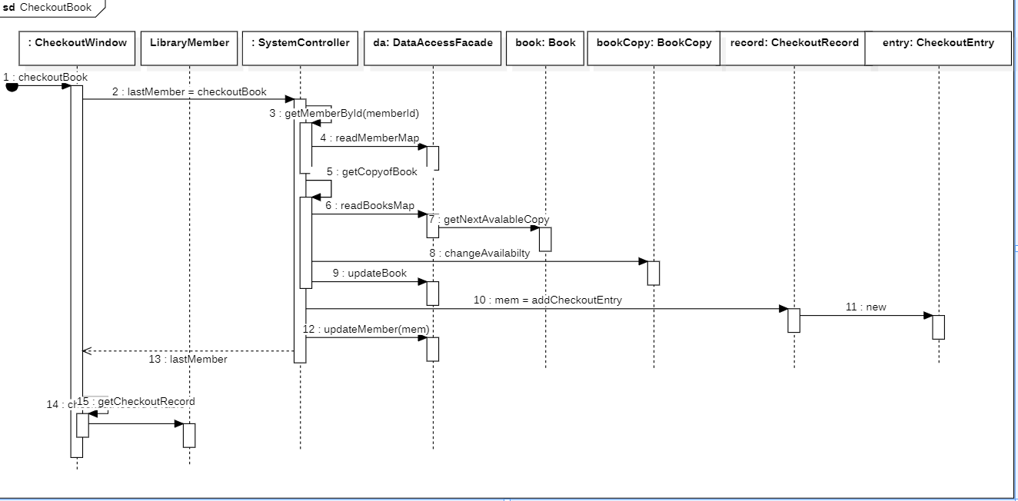
Sequence diagram for Checkout Book use case

Slide 5
Sequence diagram for Add a Copy use case

Slide 6
Sequence diagram for add a new Member use case

Slide 7
Discussion on Validation Rules of UI Windows
Many sources of validation that we’ve done: uniqness, mandatory, numberformat for pone number and ISBN

Slide 8
Conclusion with STC Knowledge

Slide 9

Git Hub reference
https://github.com/devmarwane/library-management

